Slide 1
Division Rule for Exponents
Integrated Mathematics

Slide 2
Objective
Students will apply the division rules of exponents to calculate the quotient of two mathematical terms.
Students will apply the negative and zero exponent rules to calculate the product of two or three mathematical terms.

Slide 3
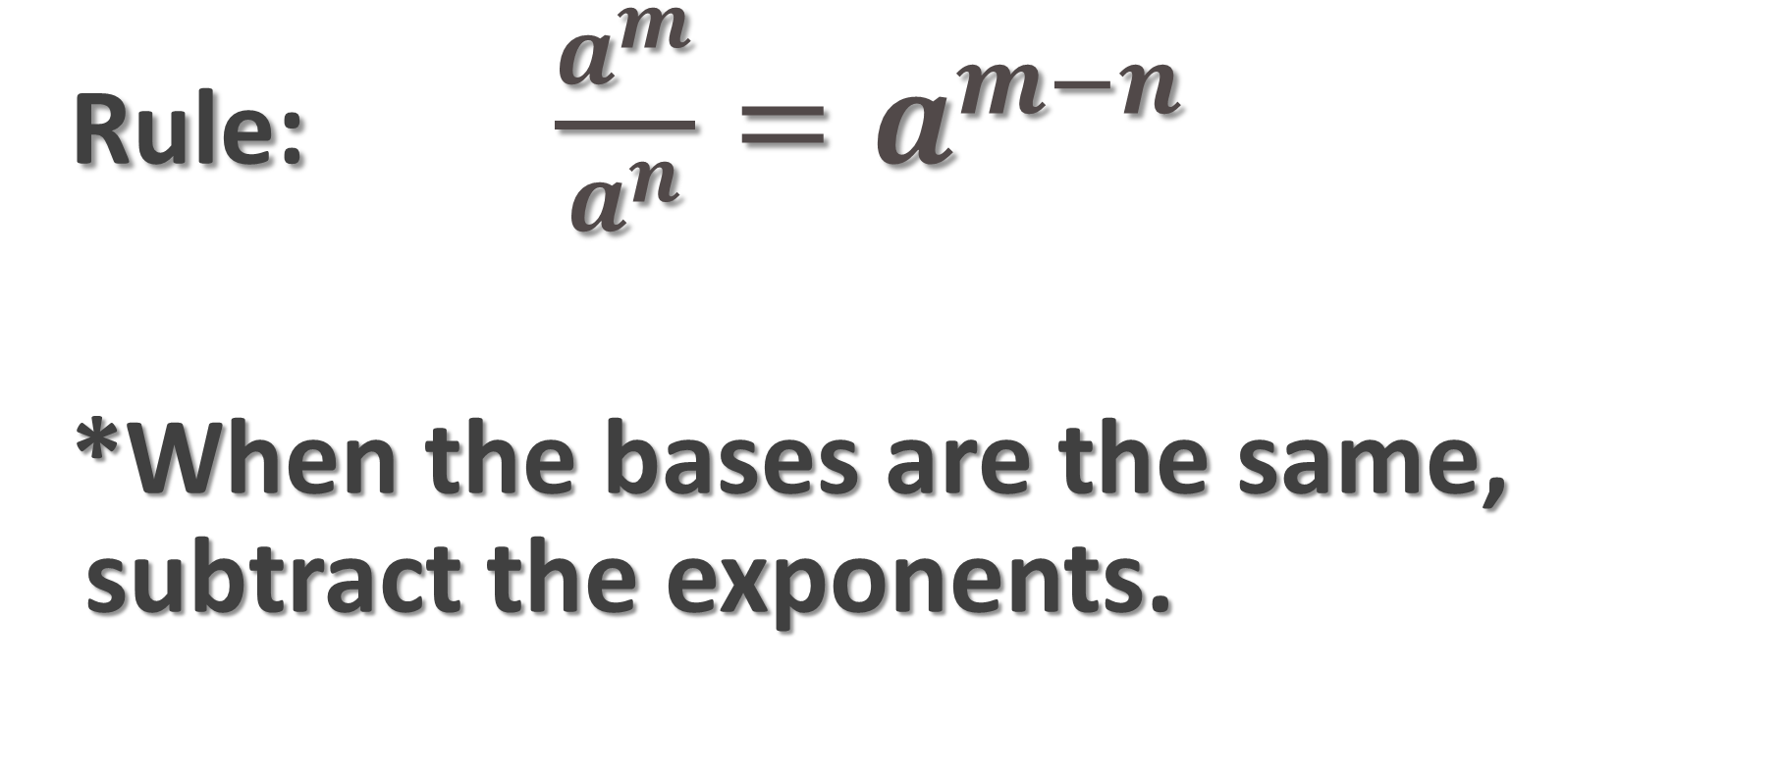
Dividing Using Exponents
Rule: $\frac{a^{m}}{a^{n}}=a^{m−n}$
*When the bases are the same, subtract the exponents.

Slide 4
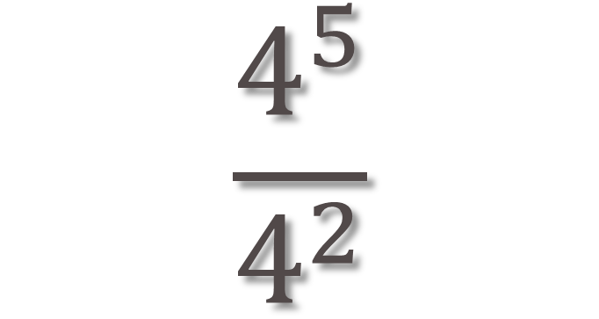
Example 1
$$\frac{4^{5}}{4^{2}}$$

Slide 5
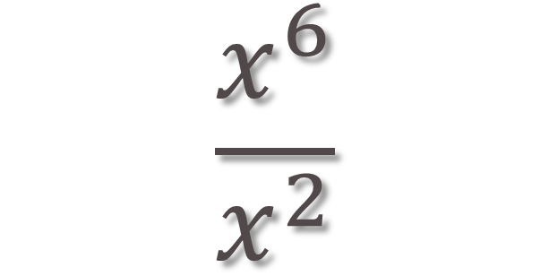
Example 2
$$\frac{x^{6}}{x^{2}}$$

Slide 6
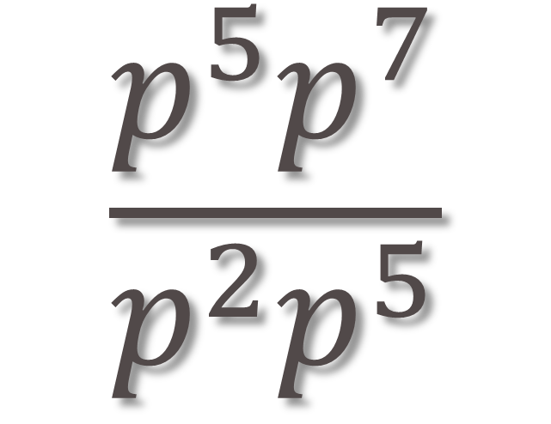
Example 3
$$\frac{p^{5}p^{7}}{p^{2}p^{5}}$$

Slide 7
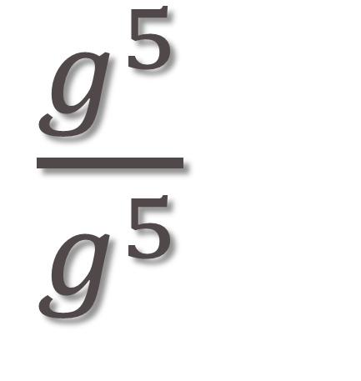
Example 4
$\frac{g^{5}}{g^{5}}$

Slide 8
Example 5
$$\frac{3x^{4}y}{6x^{2}y^{−2}}$$

Slide 9
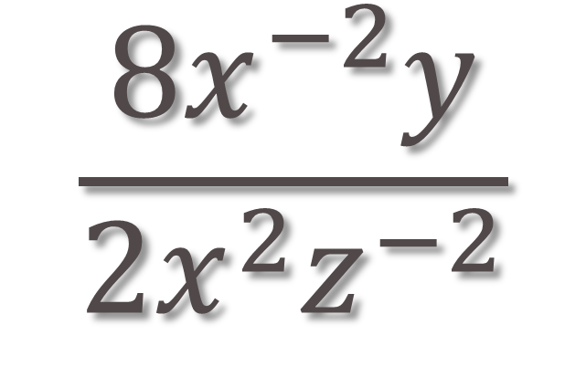
Example 6
$$\frac{8x^{−2}y}{2x^{2}z^{−2}}$$

Slide 10
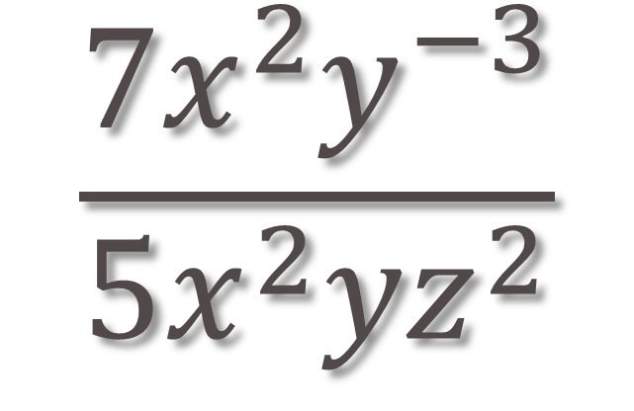
Example 7
$$\frac{{7x}^{2}y^{−3}}{5x^{2}{yz}^{2}}$$

Slide 11
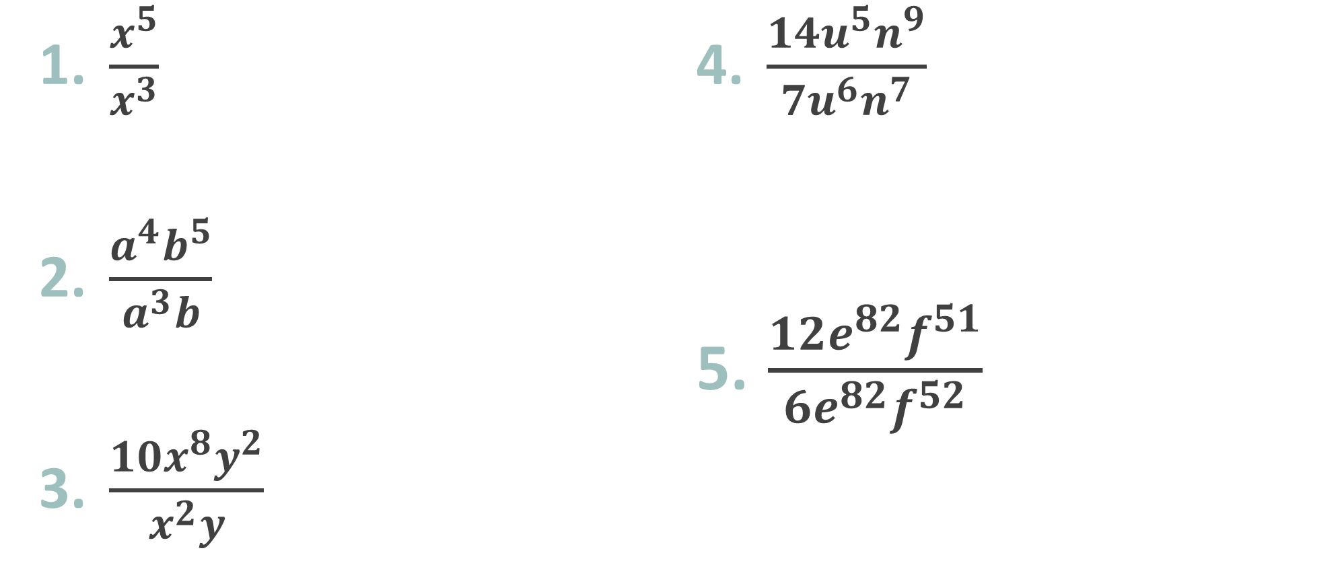
TRY THESE
$\frac{x^{5}}{x^{3}}$
$\frac{a^{4}b^{5}}{a^{3}b}$
$\frac{10x^{8}y^{2}}{x^{2}y}$
$\frac{{14u}^{5}n^{9}}{7u^{6}n^{7}}$
$\frac{{12e}^{82}f^{51}}{{6e}^{82}f^{52}}$

